Slide 1
Java Persistence with Hibernate

Slide 2
Agenda
Object/Relational Persistence and ORM
Hibernate Introduction
Caching Fundamentals
Data Access
Transaction

Slide 3
Object/Relational Persistence and ORM
Persistent data in modern object-oriented applications & efficient data management

Slide 4
What is persistence?
“Persistence”
  where data (state) outlives the process that created it
In object-oriented applications:
  objects in a system are by default transient
  some of the objects in the graph are made persistent
  this subgraph of persistent instances can later be re-created in the same process or another process
We need a data model and data store for persistent data...
The Relational Data Model and
SQL-based Database Management Systems.

Slide 5
What is persistence?
PERSISTENCE APPROACHES
1. Hand –coding a persistence layer with SQL/JDBC
A well-known and widely used DAO design pattern to hide complex JDBC code and no portable SQL from business logic.
ORM also uses DAO pattern
2. Using serialization
3. Object-oriented database system (ODBMS)
JDO (Java Data Objects) are popular.
But, object-databases are not widely adopted.
  (because of common requirement for data independence)

Slide 6
What is persistence?
PERSISTENCE APPROACHE
4. THE BEST FOR THE MOST PROBLEMS
ORM (Object-Relation Model)
  An API for performing basic CRUD operations on objects of persistent classes
  A language or API for specifying queries that refer to classes and properties of classes
  A facility for specifying mapping metadata
  A technique for the ORM implementation to interact with transactional objects to perform dirty checking, lazy association fetching and other optimization functions.

Slide 7
Object / relational mapping
What is ORM?
Why ORM?
  Productivity
  Maintainability
  Performance
  Vendor Independence
Introducing Hibernate, EJB3, and JPA
  Understanding the standards
  Hibernate Core
  Hibernate Annotations
  Hibernate EntityManager
  Java EE 5.0 application servers

Slide 8
Tabular Data vs. Domain Model
Some applications work exclusively with a tabular representation of persistent data:
  + application works with tabular result sets in all layers
  + straightforward with JDBC and SQL
  + even better with detached RowSet (JSR 114)
  hard to code re-usable business logic
Other applications have an object-oriented domain model:
  + significant business logic, benefits from object-oriented techniques such as inheritance, polymorphism, and patterns
  + greater degree of abstraction of the underlying relational data
  SQL / JDBC no longer so appropriate
  certain operations (batch processing, reporting) are more tabular in nature
Some applications benefit from both, in different places.

Slide 9
Domain Model and the paradigm mismatch
Classes implement the business entities of our domain model
  attributes of the entity are properties of our Java class
  associations between entities are also implemented with properties
Let’s see if there is a problem mapping this to tables and columns...
User
BillingDetails
userName: String
address: String
billingDetails: Set
1
1..*
accountNumber: String
accountName: String
accountType: String
user: User

Slide 10
Creating tables for the Domain Model
SQL schema design for trivial cases is ... trivial:
We’ll see the 5 problems of the O/R paradigm mismatch appear as we gradually make our model more complex…
create table USER (
USER_NAME varchar not null primary key,
ADDRESS varchar not null)
create table BILLING_DETAILS (
ACCOUNT_NUMBER varchar not null primary key,
ACCOUNT_NAME varchar not null,
ACCOUNT_TYPE varchar not null,
USER_NAME varchar foreign key references USER)

Slide 11
The problem of granularity
  should we create a new ADDRESS table?
  should we create a new SQL data type and change the column?
  user-defined data types (UDT) are not portable and the standard is weak
We usually add new columns to USER with built-in SQL data types:
Address
User
userName: String
billingDetails: Set
street: String
city: String
zipcode: String
create table USER (
USER_NAME varchar not null primary key,
ADDRESS_STREET varchar not null,
ADDRESS_CITY varchar not null,
ADDRESS_ZIPCODE varchar not null)

Slide 12
The problem of subtypes
We create subclasses of BillingDetails:
and use polymorphism in Java to implement our billing strategy.
How do we represent subtypes in our relational model?
1
1..*
User
BillingDetails
CreditCard
Cheque

Slide 13
The problem of identity
In Java, we have two notions of "sameness"
  object identity is the memory location of an object, a==b
  object equality (what is this really?), a.equals(b)
In SQL databases, we identify a particular row using the primary key and the table name.
What is the relationship between the three different types of identity in our domain model?

Slide 14
The problem of associations
Object-oriented languages represent entity relationships as
  object references (pointers) and collections of object references
Relational databases represent entity relationships as
  copies of primary key values
  referential integrity ensured by foreign key constraints
The mismatch:
  object references are directional, there is no such concept in the relational model
  many-to-many associations require a link table in relational databases

Slide 15
The problem of object graph navigation
In Java, we "walk" the object graph by following references:
  david.getBillingDetails().getAccountName()
In SQL, we join tables to get the required data:
  select * from USER u
  left outer join BILLING_DETAILS bd
  on bd.USER_ID = u.USER_ID
  where u.USERNAME = “david"

Slide 16
The cost of the mismatch
There problems can, at least theoretically, be solved using handwritten SQL/JDBC
  by writing a lot of tedious code (maybe 30% of your codebase)
  The “mismatch problem” is real
  better UDT support in SQL will not solve all the issues
  not all applications are suitable for table-oriented approaches
Is the solution design patterns (DAO)
or programming models (EJB entity beans)?
"How should we implement the persistence layer in our application?"

Slide 17
Object/Relational Mapping
Object / Relational Mapping (ORM)
  - solve the mismatch problem in middleware
  - an ORM solution transforms data from the object-oriented representation to the relational representation
  - metadata governs this transformation
Elements of an ORM implementation
  - a programming model for the domain objects
  - an API for performing CRUD operations
  - a query language or other query facility
  - a metadata facility

Slide 18
Hibernate Introduction

Slide 19
Hello World I
The Hello World program prints messages
  To demonstrate Hibernate, let’s define a persistent message
  we use a Message persistent class, POJO style
package hello;
public class Message {
private Long id;
private String text;
public String getText() {
return text;
}
public void setText(String text) {
this.text = text;
}
…
}

Slide 20
Hello World II
Messages don't have to be persistent!
  we can use our persistent classes “outside” of Hibernate
  Hibernate is able to “manage” persistent instances
  but POJO persistent classes don't depend on Hibernate
Message message = new Message("Hello World");
System.out.println( message.getText() );

Slide 21
Hello World III
Let's persist a message with Session and Transaction:
Hibernate executes this SQL:
Session session = getSessionFactory().openSession();
Transaction tx = session.beginTransaction();
Message message = new Message("Hello World");
session.save(message);
tx.commit();
session.close();
insert into MESSAGES (MESSAGE_ID, MESSAGE_TEXT)
values (1, 'Hello World')

Slide 22
Hello World IV
Let's show all persistent messages:
Session newSession = getSessionFactory().openSession();
Transaction newTransaction = newSession.beginTransaction();
List messages = newSession.find("from Message");
System.out.println( messages.size() + " message(s) found:" );
for ( Iterator iter = messages.iterator(); iter.hasNext(); ) {
Message message = (Message) iter.next();
System.out.println( message.getText() );
}
newTransaction.commit();
newSession.close();
select m.MESSAGE_ID, m.MESSAGE_TEXT from MESSAGES m

Slide 23
Hello World V
Let's update a message:
Session session = getSessionFactory().openSession();
Transaction tx = session.beginTransaction();
// 1 is the generated id of the first message
Message message = session.load( Message.class, new Long(1) );
message.setText("Greetings Earthling");
tx.commit();
session.close();
select m.MESSAGE_TEXT from MESSAGES m where m.MESSAGE_ID = 1
update MESSAGES set MESSAGE_TEXT = ‘Greetings Earthling'
Notice that we did not explicitly call any update() method - automatic dirty checking gives us more flexibility when organizing data access code!

Slide 24
Hello World VI
XML mapping metadata:
<?xml version="1.0"?>
<!DOCTYPE hibernate-mapping PUBLIC
"-//Hibernate/Hibernate Mapping DTD//EN"
"http://hibernate.sf.net/hibernate-mapping-2.0.dtd">
<hibernate-mapping>
<class
name="hello.Message"
table="MESSAGES">
<id>...</id>
<property
name="text"
column="MESSAGE_TEXT"/>
</class>
</hibernate-mapping>

Slide 25
Using C3P0 with hibernate.properties
Let's configure Hibernate to use C3P0 connection pooling
  Hibernate automatically loads hibernate.properties from a root directory of the classpath
hibernate.connection.driver_class = org.postgresql.Driver
hibernate.connection.url = jdbc:postgresql://localhost/auctiondb
hibernate.connection.username = auctionuser
hibernate.connection.password = secret
hibernate.dialect = net.sf.hibernate.dialect.PostgreSQLDialect
hibernate.c3p0.min_size = 5
hibernate.c3p0.max_size = 20
hibernate.c3p0.timeout = 1800
hibernate.c3p0.max_statements = 50
Hibernate.c3p0.validate = true
Don't forget to set the SQL dialect!

Slide 26
Starting Hibernate
We create a SessionFactory using a Configuration
  download and install JDBC driver in classpath
  copy Hibernate and the required 3rd party libraries
  chose a JDBC connection pool, customize properties
  add mapping files to the Configuration
  build the SessionFactory (immutable!)
SessionFactory sessionFactory = new Configuration()
.addResource("hello/Message.hbm.xml")
.buildSessionFactory();

Slide 27
Other configuration options
Instead of using a hibernate.properties file, we may also
  pass an instance of Properties to Configuration programmatically
  set System properties using java -Dproperty=value
  use a hibernate.cfg.xml file in the classpath
The XML-based configuration is almost equivalent to the
properties, it has some more features (cache tuning). The XML file
overrides the hibernate.properties options.
We usually prefer the XML configuration file,
especially in managed environments.

Slide 28
Hibernate Architecture
Transaction
Query
Application
Session
Session Factory
Configuration
Hibernate.cfg.xml
Hibernate.properties
Mapping files

Slide 29
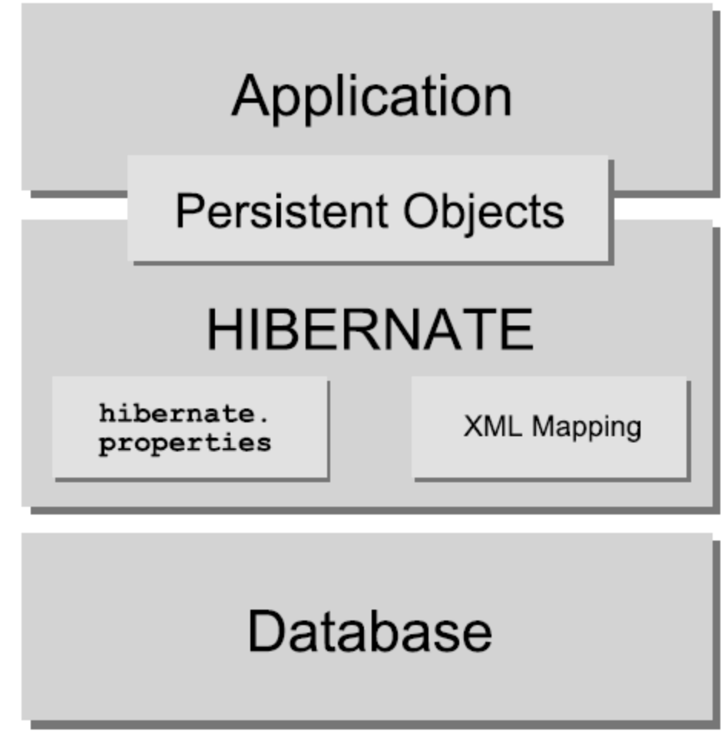
Hibernate Architecture

Slide 30
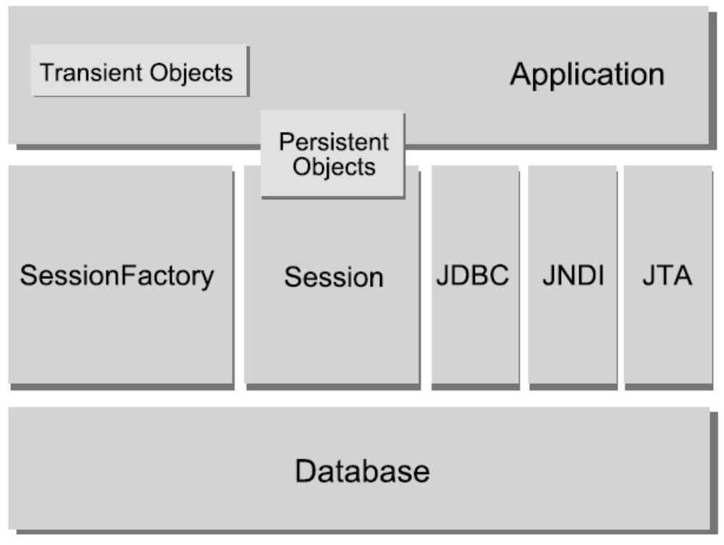
Hibernate Architecture

Slide 31
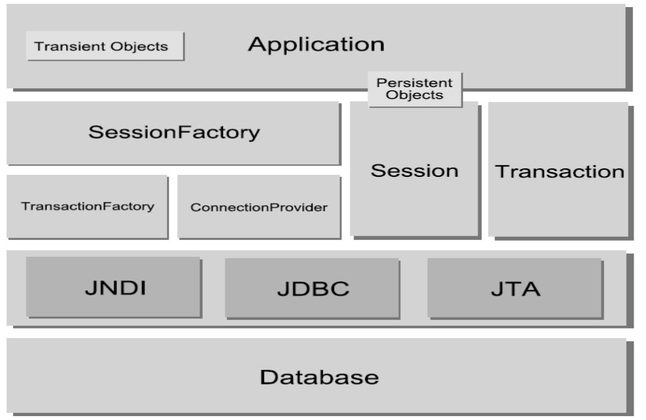
Hibernate Architecture

Slide 32
Understanding the interfaces
Hibernate dependencies in a layered application architecture:
Business Layer
Lifecycle
Interceptor
Persistent
Classes
Persistent
Classes
Validatable
UserType
Persistence Layer
Session
Transaction
Query
SessionFactory
Configuration
JNDI
JDBC
JTA

Slide 33
SessionFactory
SessionFactory (org.hibernate.SessionFactory)
A thread safe (immutable) cache of compiled mappings for a single database. A factory for Session and a client of Connection Provider. Might hold an optional (second-level) cache of data that is reusable between transactions, at a process- or cluster-level.

Slide 34
Session
Session (org.hibernate.Session)
A single-threaded, short-lived object representing a conversation between the application and the persistent store. Wraps a JDBC connection. Factory for Transaction. Holds a mandatory (first-level) cache of persistent
objects, used when navigating the object graph or looking up objects by identifier.

Slide 35
Persistent Objects and Collections
Persistent objects and collections
Short-lived, single threaded objects containing persistent state and business function. These might be ordinary JavaBeans/POJOs, the only special thing about them is that they are currently associated with (exactly one) Session. As soon as the Session is closed, they will be detached and free to use in any application layer (e.g. directly as data transfer objects to and from presentation).

Slide 36
Transient and detached objects and collections
Transient and detached objects and collections
Instances of persistent classes that are not currently associated with a Session. They may have been instantiated by the application and not (yet) persisted or they may have been instantiated by a closed Session.
.

Slide 37
Transaction
Transaction (org.hibernate.Transaction)
(Optional) A single-threaded, short-lived object used by the application to specify atomic units of work. Abstracts application from underlying JDBC, JTA or CORBA transaction. A Session might span several Transactions in some cases. However, transaction demarcation, either using the underlying API or Transaction, is never optional!
.

Slide 38
ConnectionProvider
ConnectionProvider
(org.hibernate.connection.ConnectionProvider)
(Optional) A factory for (and pool of) JDBC connections. Abstracts application from underlying Datasource or DriverManager. Not exposed to application, but can be extended/implemented by the developer.

Slide 39
TransactionFactory
TransactionFactory
(org.hibernate.TransactionFactory)
(Optional) A factory for Transaction instances. Not exposed to the application, but can be extended/implemented by the developer.

Slide 40
Extension Interfaces
Extension Interfaces
Hibernate offers many optional extension interfaces you can implement to customize the behavior of your persistence layer.(Ex. Primary key generation,SQL Dialet , Caching,JDBC connection, Proxy creationetc.,
Given a "lite" architecture, the application bypasses the Transaction/TransactionFactory and/or ConnectionProvider APIs to talk to JTA or JDBC directly.

Slide 41
Instance States
Instance states
An instance of a persistent classes may be in one of three different states, which are defined with respect to a persistence context.

Slide 42
Instance States
Transient
The instance is not, and has never been associated with any persistence context. It has no persistent identity (primary key value).

Slide 43
Instance States
Persistent
The instance is currently associated with a persistence context. It has a persistent identity (primary key value) and, perhaps, a corresponding row in the database. For a particular persistence context, Hibernate guarantees that persistent identity is equivalent to Java identity (in-memory location of the object).

Slide 44
Instance States
Detached
The instance was once associated with a persistence context, but that context was closed, or the instance was serialized to another process. It has a persistent identity and, perhaps, a corresponding row in the database.
For detached instances, Hibernate makes no guarantees about the relationship between persistent identity and Java identity.

Slide 45
Managed environments
Hibernate can be used in an application server:
Managed environment
Application
Hibernate
Transaction
Manager
EJB
Session
EJB
Transaction
Resource
Manager
EJB
Query
Each database has it's own SessionFactory!

Slide 46
Configuration: “non-managed” environments
In a “non-managed” environment (eg. Tomcat), we need a JDBC connection pool:
  C3P0, Proxool, custom ConnectionProvider
Non-managed environment
Application
Hibernate
JSP
Session
Connection
Pool
Servlet
Transaction
main()
Query

Slide 47
Managed environment with XML configuration file
<hibernate-configuration>
<session-factory name="java:hibernate/SessionFactory">
<property name="show_sql">true</property>
<property name="connection.datasource">
java:/comp/env/jdbc/HelloDB
</property>
<property name="transaction.factory_class">
net.sf.hibernate.transaction.JTATransactionFactory
</property>
<property name="transaction.manager_lookup_class">
net.sf.hibernate.transaction.JBossTransactionManagerLookup
</property>
<property name="dialect">
net.sf.hibernate.dialect.PostgreSQLDialect
</property>
<mapping resource="hello/Message.hbm.xml"/>
</session-factory>
</hibernate-configuration>

Slide 48
Caching Fundamentals

Slide 49
Cache Fundamentals
A major justification for our claim that application using an Object Relational Persistence layer are expected to outperform applications built using direct JDBC is the potential for caching.
Caching can have enormous impact on performance. Furthermore, scaling a highly concurrent application to thousand of online transactions usually require some caching to reduce the load on the database server(s).
Caching is all about performance optimization, so naturally it isn’t part of the Java Persistence of EJB 3.0 specification.
A cache keeps a representation of current database state close to the application, either in memory or on disk of the application server machine. The cache is the local copy of data.
It’s also possible to cache the result of queries.
There are three main types of cache:
  Transaction scope cache
  Process scope cache
  Cluster scope cache

Slide 50
Hibernate Cache Architecture:
Hibernate has a two-level cache architecture.
The first-level cache is the persistence context cache. A Hibernate session lifespan corresponds to either a single request or a conversation. This is mandatory first-level cache that also guarantees the scope of object and database identity.
The second-level cache in Hibernate is pluggable and may be scoped to the process or cluster. This is a cache of state(return by value), not of actual persistence instances. A cache concurrency strategy defines the transaction isolation details for a particular item of data, whereas the cache provider represents the physical cache implementation. Use of the second-level cache is optional and can be configured on a per-class and per-collection basis—each such cache utilizes its own physical cache region.
Hibernate also implements a cache for query resultsets that integrates closely with the second-level cache.

Slide 51
Hibernate’s two-level cache architecture:
First-level Cache
Persistence Context
‘’
‘’
Second-level Cache
Cache Concurrency Strategy
Query Cache
Physical Cache
Cache Provider
Class Cache
Region
Collection Cache
Region
Query Cache
Region
‘’
‘’
Update
Timestamp

Slide 52
Data Access
Persistent objects and persistence contexts

Slide 53
Object state transitions and Session methods
new
Transient
garbage
save()
saveOrUpdate()
get()
load()
find()
iterate()
etc.
delete()
Persistent
evict()
close()*
clear()*
update()
saveOrUpdate()
lock()
garbage
Detached
* affects all instances in a Session

Slide 54
Transient objects
Transient instances
  instances of a persistent class instantiated with the new operator
  transient, they have no persistent state
  garbage collected if dereferenced by the application
  have no database identity
Transient instances may be made persistent by
  calling Session.save(object)
  creating a reference from another instance that is already persistent

Slide 55
Persistent objects
Persistent instances
  include any instance retrieved with a query, lookup by identifier or navigation
  are managed, changes are automatically flushed to the database
  are transactional, changes can be rolled back in the database only
  have database identity
Persistent instances may be made transient by
  calling Session.delete(object)

Slide 56
Detached objects
Detached instances
  are instances with database identity that are not associated with any open Session
  are no longer managed by Hibernate
  represent database state, that is potentially stale
Persistent instances become detached by
  calling Session.evict(object)
  clearing the Session Session.clear()
  closing the Session Session.close()
Detached instances become persistent by
  calling Session.lock(object, lockMode)
  calling Session.update(object, lockMode)
  creating a reference from another instance that is already persistent

Slide 57
The Persistence Context
Automatic dirty checking
  Automatic dirty checking,
  Transparent transaction-level write-behind
The persistence context cache
  Automatic dirty checking is one of the benefits of this caching.
  Another benefit is repeatable read
  Repeatable read: if the hibernate is told to load an object by primary key (a lookup by identifier), it can first check the persistence context for the current unit of work. If the entity is found there, no database hits occur—this is a repeatable read for an application.

Slide 58
The scope of object identity
It is extremely important to understand the differences between
  Java object identity: a == b
  Database identity: a.getId().equals(b.getId()
The conditions when both are equivalent
is called the scope of object identity!
For this scope, there are three common choices:
  no identity scope
    Makes no guarantee that if a row is accessed twice the same Java object instance will be returned by the application.
  persistence context-scoped identity
    Guarantees that, in the scope of single persistence context, only one object instance represents a particular database row.
  process-scoped identity
    Goes one step further and guarantees that only one object instance represents the row in the whole process (JVM).
Hibernate implements session-scoped identity – the two notions of identity are equivalent for instances associated with a particular session.

Slide 59
The Hibernate identity scope
Session session1 = sf.openSession();
Transaction tx1 = session.beginTransaction();
Object a = session1.load(Category.class, new Long(1234) );
Object b = session1.load(Category.class, new Long(1234) );
if ( a == b )
System.out.println("a and b are identicial and the same database identity.");
tx1.commit();
session1.close();
Session session2 = sf.openSession();
Transaction tx2 = session.beginTransaction();
Object b2 = session2.load(Category.class, new Long(1234) );
if ( a != b2 )
System.out.println("a and b2 are not identical.");
tx2.commit();
session2.close();

Slide 60
Outside of the identity scope
In an instance becomes detached,
it leaves the scope of object identity.
So, if we use detached instances in our application, we should not use == to test for identity. What should we use instead?

Slide 61
Identity and equality contracts
Do we have to implement equals()and hashCode()?
  the default implementation uses Java object identity
  no good for detached objects
  especially not if we put them in collections:
Session session1 = sf.openSession();
Transaction tx1 = session.beginTransaction();
Object itemA = session1.load(Item.class, new Long(1234) );
tx1.commit();
session1.close();
Session session2 = sf.openSession();
Transaction tx2 = session.beginTransaction();
Object itemB = session2.load(Item.class, new Long(1234) );
tx2.commit();
session2.close();
Set allObjects = new HashSet();
allObjects.add(itemA);
allObjects.add(itemB);
System.out.println(allObjects.size()); // How many elements?

Slide 62
Implementing equals() and hashCode()
Could we compare identifiers?
  for entities with surrogate keys, it is uninitialized for transient instances
  identity of the instance changes when it becomes persistent, contrary to the contract of java.util.Set (the hashcode changes)
Could we compare all properties except for the surrogate key?
  identity of the instance changes when we modify the object, contrary to the contract of java.util.Set (the hashcode changes)
  could potentially cause initialization of a whole graph of associated objects, just to evaluate equals()
  two instances with the same database identity might not be equal!
  Can two instances with different database identity be equal?

Slide 63
Using business keys for equality
A business key is a property or a combination of properties that is
  unique for each instance with the same database identity
  unique, constant and not null only for the comparison time span
public class Item {
public boolean equals(Object other) {
if (this == other) return true;
if (!(other instanceof Item)) return false;
final Item item = (Item) other;
if (!getSummary().equals(item.getSummary())) return false;
if (!getCreated().equals(item.getCreated())) return false;
return true;
}
public int hashCode() {
int result;
result = getSummary().hashCode();
return 29 * result + getCreated().hashCode();
}
}

Slide 64
The Hibernate Session
The Hibernate Session is the persistence manager interface for
  basic CRUD (create, read, update, delete) operations (Session)
  query execution (Session, Query, Criteria)
  control of transactions (Transaction)
  management of the transaction-level cache
At the beginning of a unit-of-work, the application thread
  looks up the SessionFactory
  obtains a Session
A SessionFactory is expensive to create, a Session is not!
In fact, a Session only obtains a JDBC connection when needed.

Slide 65
Making an object persistent
Hibernate executes SQL only as neccessary, in this case,
when the Transaction is committed. Hibernate uses
a transaction-scope write-behind strategy.
User user = new User();
user.getName().setFirstName("John");
user.getName().setLastName("Doe");
Session session = sessions.openSession();
Transaction tx = session.beginTransaction();
session.save(user);
tx.commit();
session.close();

Slide 66
Updating a detached instance
The call to update() attaches the detached instance
with the new Session, it doesn't matter if it's modified before or
after the update(). The version check occurs when the transaction commits and Hibernate executes SQL.
user.setPassword("secret");
Session sessionTwo = sessions.openSession();
Transaction tx = sessionTwo.beginTransaction();
sessionTwo.update(user);
user.setLoginName("jonny");
tx.commit();
sessionTwo.close();

Slide 67
Locking a detached instance
Changes made before the call to lock() are not synchronized with the database. In this example, we don't even perform a version check (LockMode.NONE), only reattach the object.
If we specifty Lockmode.READ or LockMode.UPGRADE, Hibernate would execute a SELECT statement in order to perform a version check( and to set an upgrade lock).
Session sessionTwo = sessions.openSession();
Transaction tx = sessionTwo.beginTransaction();
sessionTwo.lock(user, LockMode.NONE);
user.setPassword("secret");
user.setLoginName("jonny");
tx.commit();
sessionTwo.close();

Slide 68
Retrieving objects
Objects looked up by their identifier value are associated with a Session and automatically dirty-checked inside a Session.
Session session = sessions.openSession();
Transaction tx = session.beginTransaction();
int userID = 1234;
User user = session.get(User.class, new Long(userID));
// "user" might be null if it doesn't exist
tx.commit();
session.close();

Slide 69
Making a persistent object transient
Deleted objects are transient after the Session is closed
and will be garbage collected if they are no longer
referenced by other objects
Session session = sessions.openSession();
Transaction tx = session.beginTransaction();
int userID = 1234;
User user = session.get(User.class, new Long(userID));
session.delete(user);
tx.commit();
session.close();

Slide 70
Making a detached object transient
Detached objects can be directly reattached and
scheduled for deletion in a single call.
Session session = sessions.openSession();
Transaction tx = session.beginTransaction();
session.delete(user);
tx.commit();
session.close();

Slide 71
Persistence by reachability
An object becomes persistence if it is referenced:
Electronics: Category
Cell Phones: Category
Computer: Category
Desktop PCs: Category
Monitors: Category
Transient
Persistent
Persistent by Reachability

Slide 72
Association cascade styles
Hibernate supports more flexible cascading options for associations:
  none: Hibernate ignores the association
  save-update: Hibernate saves new and updates detached instances
  delete: Hibernate deletes associated instances
  all: save-update and delete
  all-delete-orphans: Hibernate will delete dereferenced instances
Cascading options can be declared on an association-basis.
This model is more flexible but more complex model than persistence by reachability.
This model allows fine-grained reattachment of
detached instances (sounds impressive?)...

Slide 73
Association cascade styles
Let’s enable transitive persistence for the Category hierarchy:
  Usually, we apply cascade only for to-many associations.
  Note that cascade is a recursive notion!
<class name=“Category” … >
…
<many-to-one name=“parentCategory”
column=“PARENT_ID”
cascade=“none” />
<set name=“childCategories” cascade=“save-update” … >
<key column=“PARENT_ID”/>
<one-to-many class=“Category”/>
</set>
</class>

Slide 74
Automatic save or update for detached object graphs
If we don’t know if something is detached or transient:
  Hibernate will walk the graph, starting at the “root” object passed to saveOrUpdate(), navigating to all associated entities where the association is declared cascade="save-update“.
  Hibernate will decide if each object in the graph needs to be inserted or updated.
Session session = sessionFactory.openSession();
Transaction tx = session.beginTransaction();
// Let Hibernate decide whats new and whats detached
session.saveOrUpdate(theRootObjectOfGraph);
tx.commit();
session.close();

Slide 75
Detecting transient instances
Hibernate will assume that an instance is transient if
  the identifier property is null
  the version or timestamp property (if there is one) is null
  the unsaved-value for the identifier property defined in the mapping matches
  the unsaved-value for the version or timestamp property defined in the mapping matches
  you implement your own strategy with an Interceptor
<class name="Category" table="CATEGORY">
<!-- null is the default, '0' is for primitive types -->
<id name="id" unsaved-value="0">
<generator class="native"/>
</id>
....
</class>

Slide 76
Transactions
Managing concurrent data access

Slide 77
Transactions
All operations inside a transaction either complete or fail:
Transaction Succeeded
commit
begin
Transaction
Initial State
rollback
Transaction Failed

Slide 78
Hibernate transaction support
Hibernate supports transactions with
  JDBC transaction management if we use a connection pool directly
  JTA transactions in Application Servers
  any custom TransactionFactory and Transaction implementation
  Programmatic Transaction Demarcation
  java.sql.Connection
  org.hibernate.Transaction
  javax.transaction.UserTransaction (JTA)
  javax.persistence.EntityTransaction
  Declarative Transaction Demarcation
  The Hibernate Transaction API hides the underlying
strategy and keeps our persistence layer code portable.

Slide 79
Transaction in Hibernate Application
Use the Transaction API to control system/database transactions:
Committing the Transaction flushes the Session.
Can we have several Transactions per Session?
Session session = sessions.openSession();
Transaction tx = null;
try {
tx = session.beginTransaction();
concludeAuction();
tx.commit();
}
catch (Exception e) {
if (tx != null) tx.rollback();
throw e;
}
finally
session.close();
}

Slide 80
Session flushing and closing
A flush synchronizes the Session state with the database
  Hibernate uses write-behind for SQL execution
  Hibernate uses JDBC batch-updates
A flush occurs
  when a Transaction is committed
  before a query is executed (for correct query results)
  when an application calls Session.flush()
We can control this behavior by setting a FlushMode for a particular Session. This is useful for some rare cases with database triggers.
Always close the Session and don’t forget to
discard it if any exception occurs.

Slide 81
References
www.hibernate.org
JAVA Persistence with HIBERNATE
  Christian Bauer
  Gavin King

